Slide 1

An Orthopod’s Journey to
Better Health, Performance, &
Longevity
Case Study: Dr Craig Wilson

Slide 2



DISCLAIMER

Slide 3
THE REALITY
WHY STAYING HEALTHY IS HARD FOR SURGEONS?
LONG,
UNPREDICTABLE HOURS
CONSTANT EXHAUSTION
HIGH COGNITIVE, EMOTIONAL, & PHYSICAL LOAD
RIGHT INTENTION, WRONG SOLUTION
THE RESULT: FRUSTRATION, INCONSISTENCY, AND SLOW “HEALTH DRIFT” ACROSS A CAREER.

Slide 4
THE GOAL
NOT A PERFECT LIFESTYLE.
A SUSTAINABLE SYSTEM.
NOT THIS
THIS INSTEAD
A perfect lifestyle
with zero flexibility...
Systems that sustain…
PERFORMANCE
ENERGY
HEALTH
RIGID PLANS BREAK THE FIRST TIME THE CALL SCHEDULE CHANGES, THEN GUILT TAKES OVER.
LONGEVITY
THAT'S WHAT THE 4 PILLAR SYSTEM IS BUILT TO DO.

Slide 5
THE FRAMEWORK
THE 4 PILLAR SYSTEM
FOR SUSTAINABLE PROGRESS ACROSS A DEMANDING SURGICAL CAREER
PHYSICAL FITNESS
NUTRITION
Protein-centered nutrition built around your real life.
REALISTIC, PROGRESSIVE TRAINING THAT FITS YOUR SCHEDULE
SLEEP
ACCOUNTABILITY
CONSISTENCY & OPTIMIZING OVER CHASING 8 HOURS THAT DOESN’T EXIST
TRACKING AND SUPPORT THAT CATCH DRIFT EARLY

Slide 6
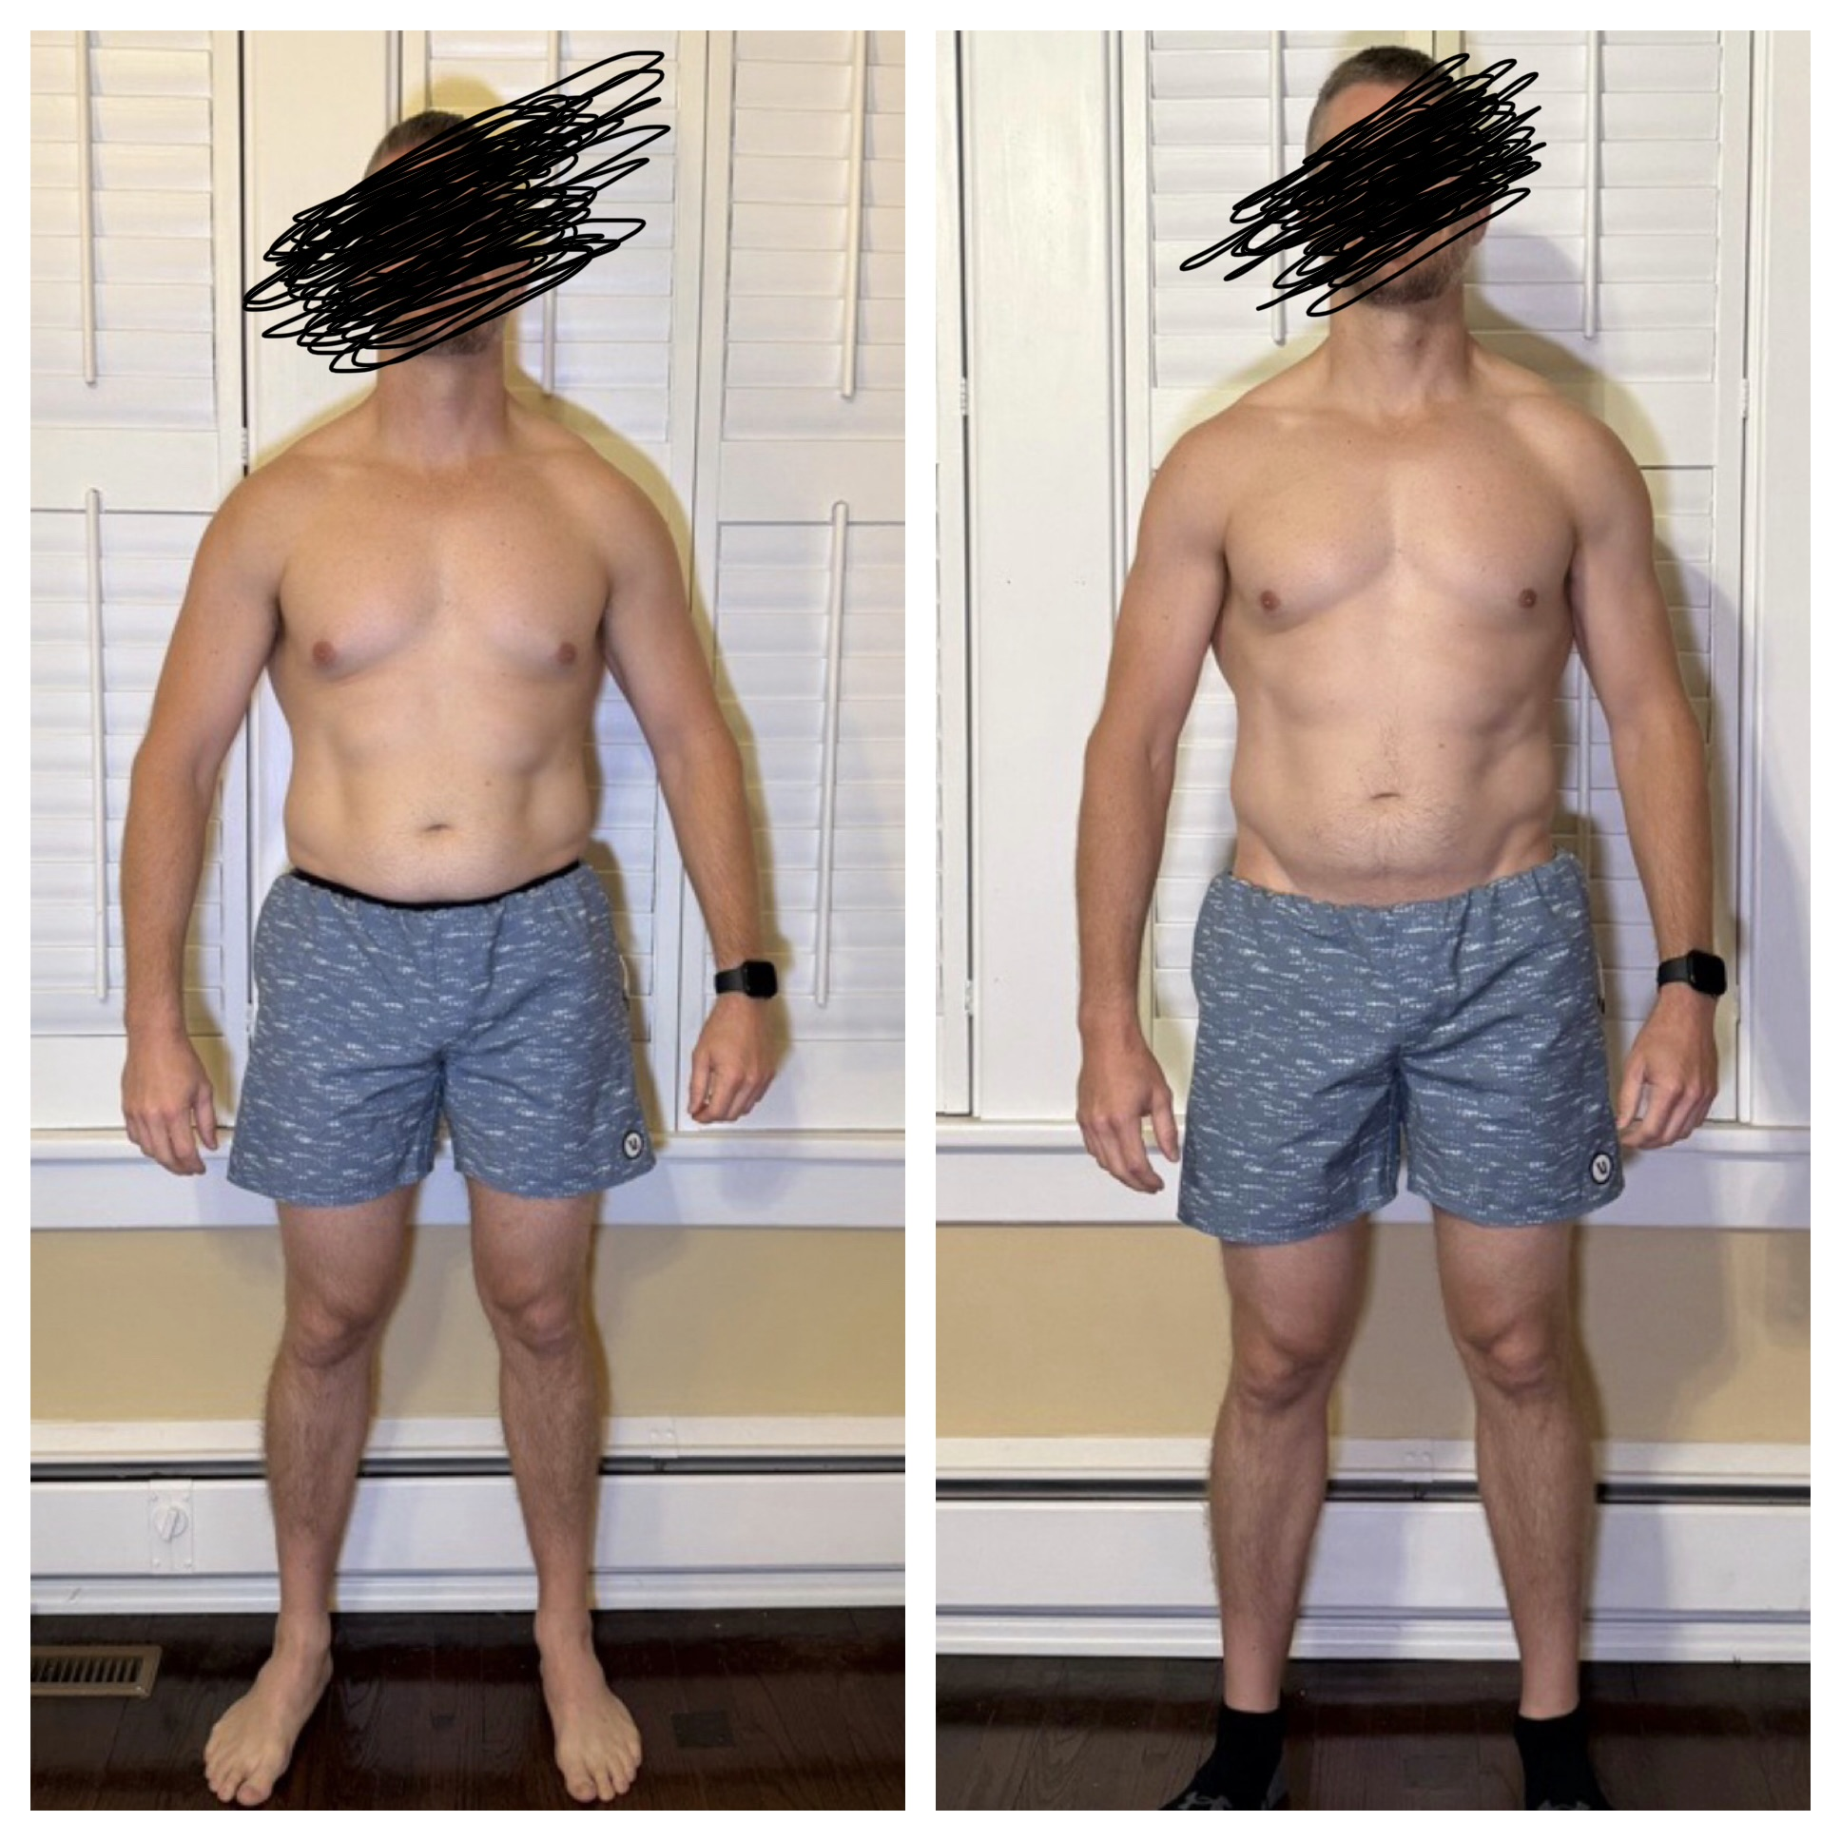

Slide 7
PUTTING IT INTO PRACTICE
PRACTICAL ACTION STEPS
FITNESS
NUTRITION
SLEEP
ACCOUNTABILITY
PICK A REALISTIC WEEKLY FREQUENCY
INCREASE PROTEIN INTAKE
FIX A CONSISTENT SLEEP WINDOW
SCHEDULE HABITS LIKE CASES
SET A MINIMUM MOVEMENT “FLOOR”
IMPROVE YOUR HOME & WORK SETUP
IMPROVE YOUR SLEEP ENVIRONMENT
TRACK YOUR PROGRESS
REMOVE YOUR BIGGEST BARRIER
AUTOMATE YOUR NUTRITION
CUT STIMULATION BEFORE BED
USE A SUPPORT SYSTEM

Slide 8
HABIT BUILDING
YOUR FIRST STEP: MAP-E IT OUT
STEP 1
M
MOTIVATION
How long has this been something you've wanted to change?
CHOOSE ONE
CATEGORY
FITNESS
A
ABILITY
What gives you confidence you can actually do this?
NUTRITION
SLEEP
P
PROMPT / ENVIRONMENT
How can your environment, tech, home, and workplace make success easier?
ACCOUNTABILITY
CHOOSE AN ACTION WITH AT LEAST 80% CONFIDENCE.
IDENTIFY YOUR SINGLE BIGGEST BOTTLENECK FIRST.
If it seems too easy, prove it. Hesitating because it feels “too easy” when you've never actually done it consistently, that's ego, not insight.

Slide 9
THE TAKEAWAY
“THE GOAL IS NOT A PERFECT LIFESTYLE.
IT'S SYSTEMS THAT LET SURGEONS PERFORM
AT THEIR HIGHEST LEVEL FOR AN ENTIRE CAREER.”
YOUR CHALLENGE TONIGHT
WHAT IS ONE ACTION YOU WILL TAKE TONIGHT?
FITNESS · NUTRITION · SLEEP · ACCOUNTABILITY

Slide 10

Thank You
Email: mike@annarbortrainer.com

